Slide 1

Customer Shopping Behavior Analysis
Analyzing 3,900 transactions across multiple product categories to uncover purchasing trends, customer segments, and subscription engagement patterns that drive strategic decision-making.

Slide 2
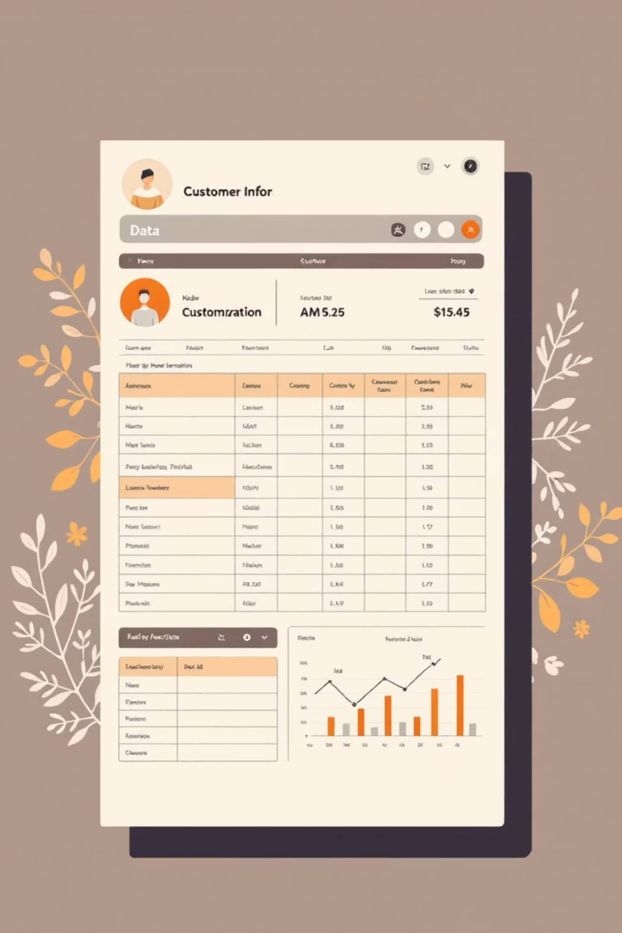
Dataset Overview
3,900
18
37
Total Transactions
Data Columns
Missing Values
Rich feature set for deep insights
Only in Review Rating column
Comprehensive purchase records analyzed
50
Unique Locations
Diverse geographic coverage

Slide 3
Data Preparation & Engineering
01
02
Data Loading & Exploration
Missing Data Handling
Dataset imported via pandas with structural assessment using df.info() and statistical summaries via df.describe().
Review Rating nulls filled using median rating per product category to maintain data integrity.
03
04
Feature Engineering
Database Integration
Created age_group and purchase_frequency_days columns. Standardized column names to snake_case format.
Processed DataFrame transferred to PostgreSQL for advanced SQL-based analysis.

Slide 4

Revenue Insights by Demographics
Gender Revenue Analysis
Age Group Performance
Male customers generate significantly higher revenue at $157,890 compared to female customers at $75,191, indicating potential for targeted marketing strategies.
Young: $62,143 (highest revenue)
Middle-aged: $59,197
Adult: $55,978
Old: $55,763
Younger demographics show strongest purchasing power.

Slide 5



Customer Segmentation Analysis
New
1
83 customers
Returning
2
701 customers
Loyal
3
3,116 customers
Customer base dominated by loyal segment (80%), demonstrating strong retention. Returning customers represent key conversion opportunity for subscription growth.

Slide 6

Subscription & Spending Patterns
Subscribers
1,053 customers
Average spent: $59.49
Total revenue: $62,645
Non-Subscribers
2,847 customers
Average spent: $59.87
Total revenue: $170,436
Repeat buyers (5+ purchases) show higher subscription propensity with 958 subscribers versus 2,518 non-subscribers, indicating opportunity for targeted conversion campaigns.

Slide 7

Product Performance Insights
Top-Rated Products
Discount-Dependent Items
Gloves (3.86 rating)
Sandals (3.84 rating)
Hat (50% discount rate)
Boots (3.82 rating)
Sneakers (49.66%)
Hat (3.80 rating)
Coat (49.07%)
Skirt (3.78 rating)
Sweater (48.17%)
Pants (47.37%)

Slide 8
Shipping & Discount Analysis
Express Shipping
Standard Shipping
High-Spending Discount Users
Average purchase: $60.48
Average purchase: $58.46
Higher spending behavior indicates premium customer segment willing to pay for faster delivery.
Cost-conscious customers with slightly lower basket values.
839 customers using discounts exceeded average transaction value, demonstrating opportunity for tiered pricing strategies.

Slide 9

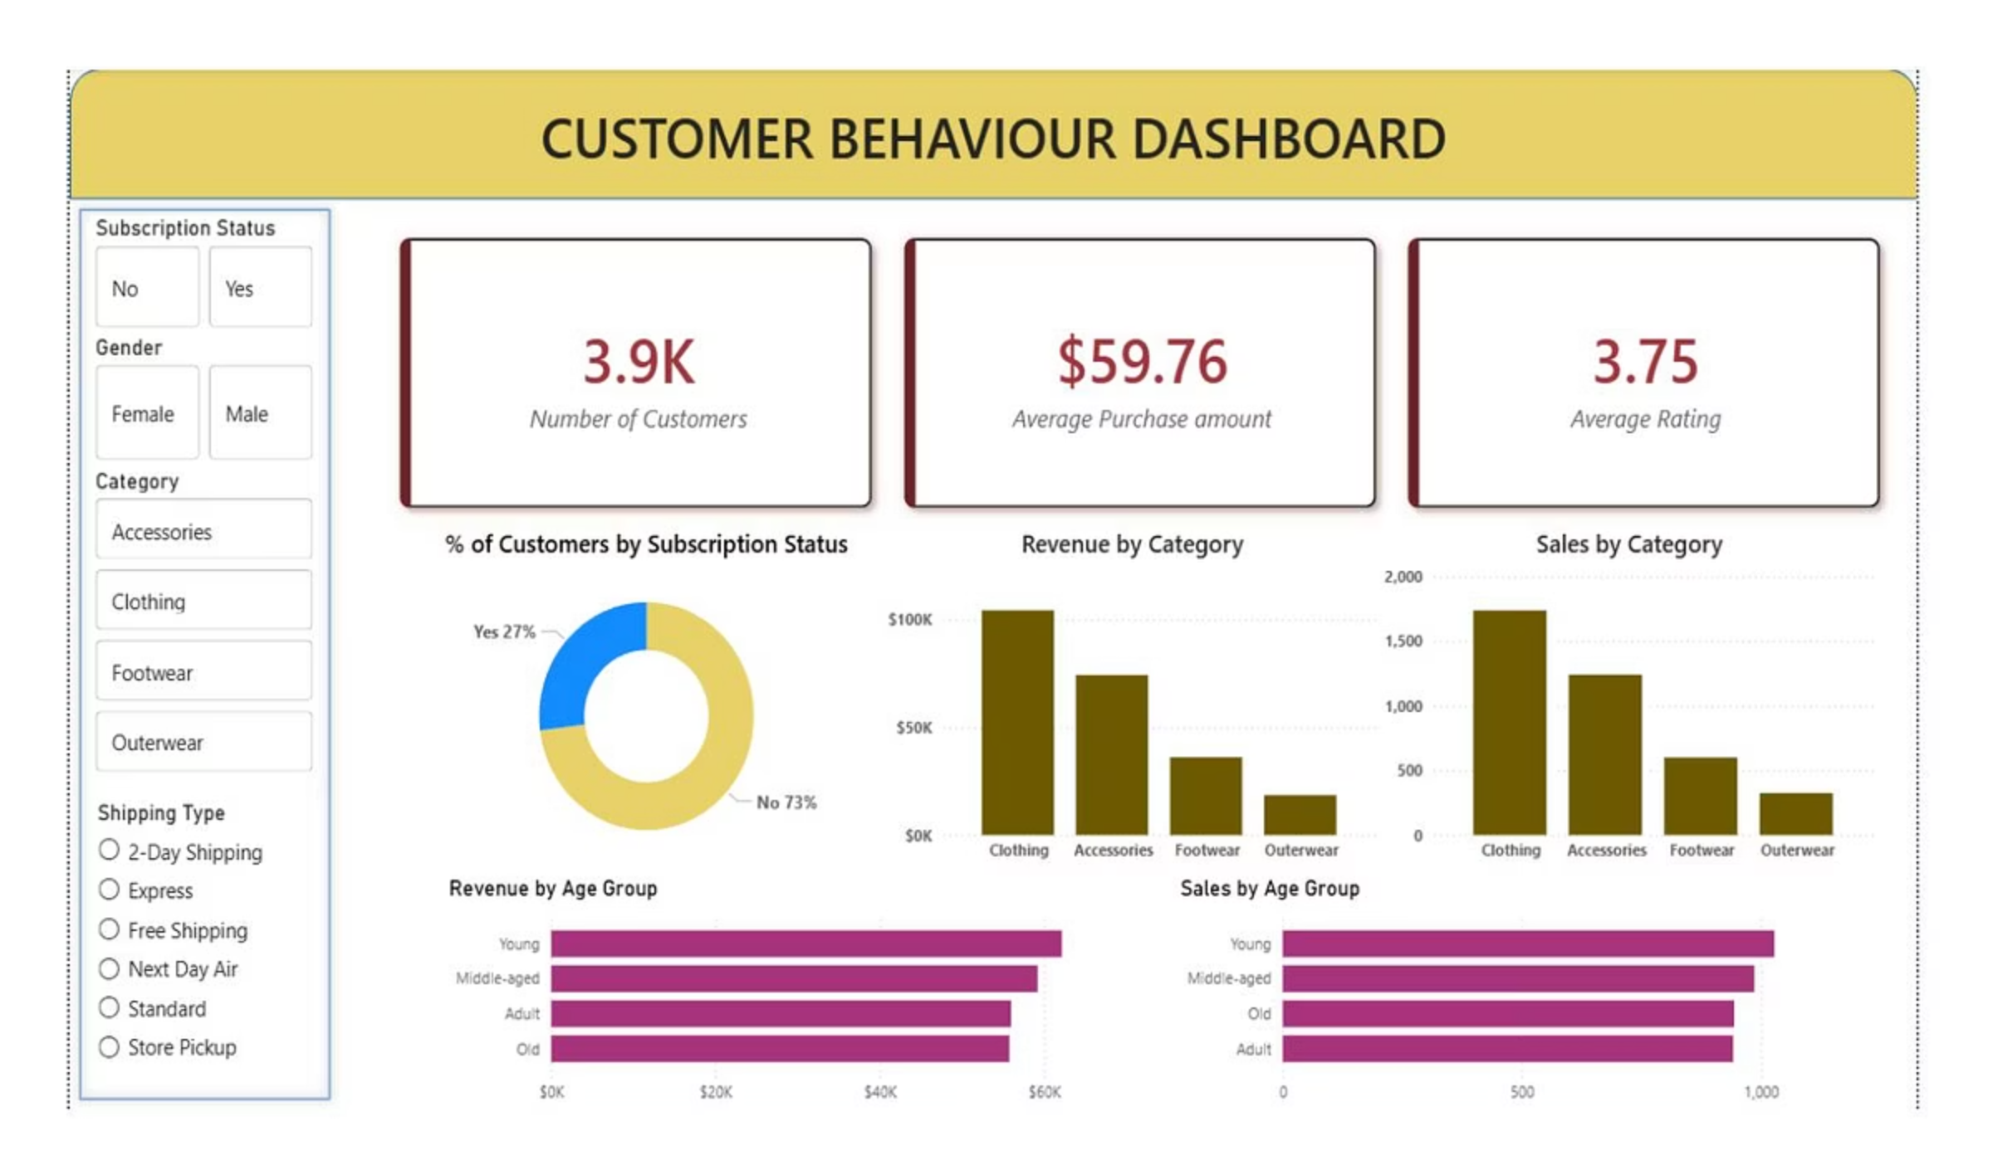
Interactive Dashboard
Comprehensive Power BI visualization platform showcasing key metrics, trends, and customer insights for real-time decision-making and strategic planning.

Slide 10

Strategic Recommendations
Dynamic Shipping Thresholds
Seasonal Inventory Allocation
Volume-Based Discounting
Introduce free express shipping threshold above current average to encourage larger basket sizes from premium customers.
Dynamically adjust stock levels using seasonal sales data to reduce warehousing costs for off-peak merchandise.
Shift to tiered offers targeting high-spending discount users to protect margins while incentivizing bulk purchases.
Demographic-Led Bundling
Targeted Subscription Conversion
Create curated product bundles tailored to highest-revenue age groups identified in demographic analysis.
Focus marketing efforts on "Returning" segment (2-5 purchases) showing highest probability of upgrading to recurring revenue model.

